Slide 1
Category review: Chips
June 2020
Retail Analytics
Brand note: If client logo is not required, use alternate title page layout right click slide thumbnail > Layout > Title

Slide 2
Notes:
To view Privacy video explaining how important data privacy is to Quantium, please click here: https://www.youtube.com/watch?v=Zq1QDAkoRzU
or here Q:\Company Reference\Brand & Design\Brand videos\Q Privacy.mp4
At Quantium, we believe that data is the behavioural footprint of humanity and that it has to be treated with the utmost care and responsibility.
Histories, attitudes, indeed lives are stored within it in ways that aren’t always apparent – and that’s what makes its potential so powerful.
To work with it responsibly, sensitively, we set ourselves the highest data privacy protection and governance standards.
We have spent 17 years perfecting privacy-by-design and secure-by-design principles. Central to this is not holding any personally identifiable information about people –
we neither receive it, and put the necessary protections in place to be unable to decipher it.
Every aspect of handling data is safeguarded: from its de-identification, to its encryption – data security is paramount and of the highest grade.
We pride ourselves on gaining the trust of iconic organisations around the world through years of securely working with their data,
and in turn the trust that builds with their stakeholders.

Slide 3
Executive summary
01
Task 1
As part of Task 1, I cleaned the dataset and found the following insights:
● Old Singles/Couples are the highest spenders based on LIFESTAGE.
● Surprisingly Mainstream customers spent the most, surpassing both Budget and Premium segments.
● The top-selling brands are Kettle, Smiths, Doritos, Pringles and RRD with Kettle being the most popular.
● Most sold pack sizes are 175g, 150g, 134g, 110g and 170g.
● Kettle chips and 175g packs should be stocked regularly.
02
Task 2
As part of Task 2, I analyzed the performance of Trial Stores compared to Control Stores.
Trail Stores performed well and better than Control Stores.
Store 77 only have a small difference in revenue compared to Control Store while other Trail Stores generated a good revenue.
Its worth rechecking the Store 77 whether the setup was something different.

Slide 4
01
Category

Slide 5
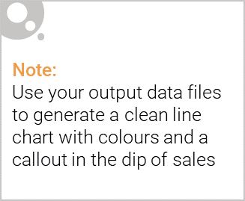
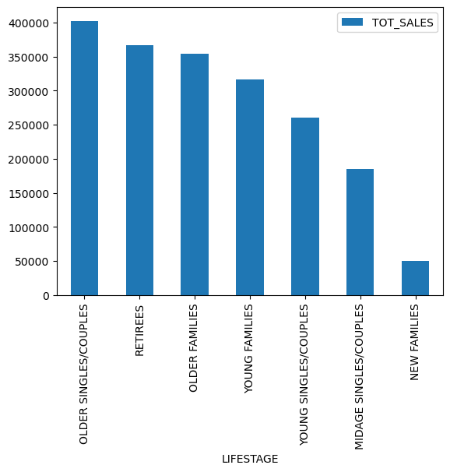
Overview: Categorizing and analyzing based on Life Stage reveals that Mainstream Customers and Old Singles/Couples are the highest spenders.

Slide 6

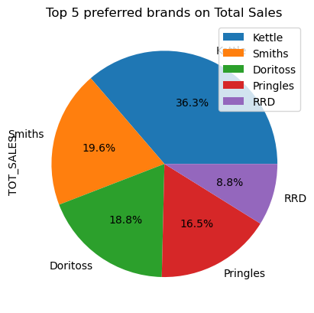
Lifestage, brand, and pack size significantly influence consumer spending in the chips category.

Slide 7
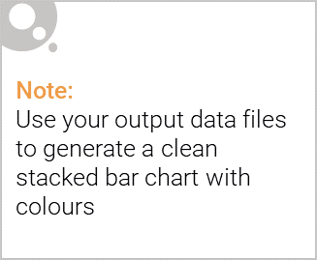
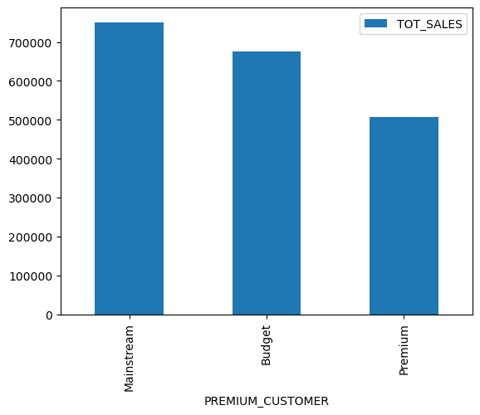
Editable (delete this)

Slide 8
02
Trial store performance

Slide 9
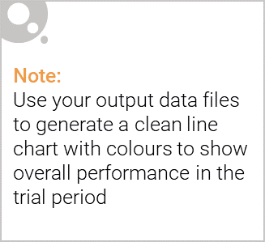
Explanation of the control store vs other stores
The control stores were identified by selecting the store with the highest correlation to each trial store based on key sales metrics.
First, the trial stores (77, 86, 88) were excluded from the dataset.
Then, for each trial store, correlation values were calculated between its sales metrics and those of all remaining stores.
The store with the highest correlation was chosen as the corresponding control store.
This ensures that the control stores closely resemble the trial stores in terms of sales behavior before the intervention, allowing for a meaningful comparison.

Slide 10
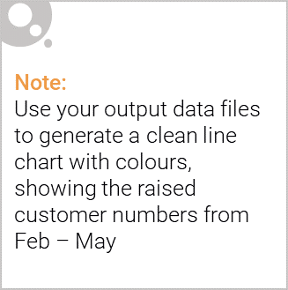
The trial stores showed an overall increase in total sales, indicating a positive impact.
However, despite higher revenue, the number of transactions declined, suggesting a potential pricing strategy difference.
Notably, Store 77 underperformed compared to other trial stores, warranting further investigation to determine if its setup differed.
To assess true success, we need to confirm whether the revenue growth aligns with expected outcomes or if external factors influenced performance.

